Slide 1
CDF, Inc. Analysis Talent Management
DDSAnalytics
By Solange Garcia de Alford

Slide 2
DDSAnalytics
Executive Summary
Talent management is at the forefront of CDF’s business strategy. One of the most valuable assets at CDF are the Employees that form the company.
CDF’s decision to analyze the company’s attrition is to ensure CDF continues to maintain its place as the leader in the industry. Each one of CDF’s Employees is key to the success of the enterprise and to gain a competitive edge over its competition.
DDSAnalytics was engaged by CDF to provide business intelligence to help retain its employees.
This analysis covers:
Attrition Trends
Top factors that contribute to CDF’s employee turnover
Attrition Prediction Model

Slide 3

DDSAnalytics Employee Data
DDSAnalytics worked with a data set of 1,470 CDF’s employee records including important information on an employee’s:
Years at the company
Monthly income
Years in current role
These data was analyzed to find answers to the following questions of interest:
What are the main causes of employee turnover at CDF?
What is the expected attrition?

Slide 4
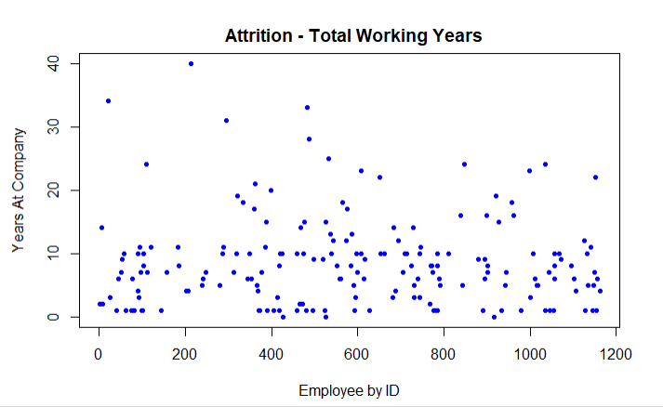
DDSAnalytics Attrition Trends

Slide 5

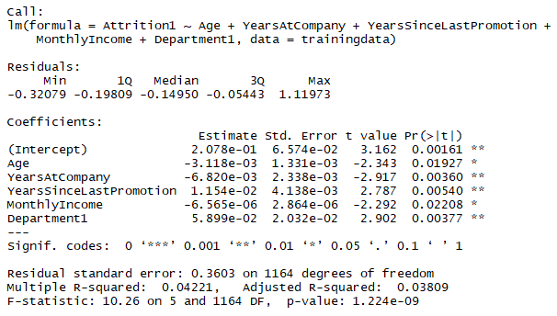
DDSAnalytics Attrition Top Factors
Three (3) Top Factors Contributing to CDF’s Attrition
Years since last promotion
Income
Years with the company

Slide 6
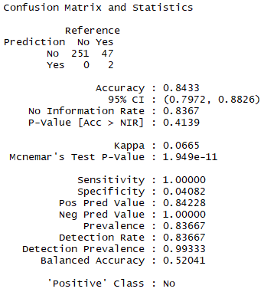
DDSAnalytics Expected Attrition
Prediction Model
84% accuracy based on our research
Cross validation with 300 CDF employee records
Out of 300 records, the model predicted 253 values correctly.

Slide 7
Appendix

Slide 8
DDSAnalytics Outline
Executive Summary
Data description
Encoding of response variable since the response variable is a categorical variable
Analytical Approach
Trends
Modeling selection
Fitting the model
Prediction

